Slide 1
Master Thesis: Colloquium ASCII ACKNOWLEDGMENT RESPONSE SYSTEM FOR G4 PRODUCT PLATFORM
In fulfilment of the Requirements for Academic Degree M.Sc. in Embedded Systems Design at Hochschule Bremerhaven and carried out at Wenglor MEL
Presented by
Joe Joseph Nelson (38750)
Under Supervision of
Prof. Dr.-Ing. Uwe Werner, Hochschule Bremerhaven
Dipl. Manfred Huber (Wenglor MEL)
Mahesh Ramesh Ingle (Wenglor MEL)

Slide 2
AGENDA
Introduction
Motivation and Objectives
Methodology
Results
Conclusion and Future Scope

Slide 3
INTRODUCTION
Section I

Slide 4
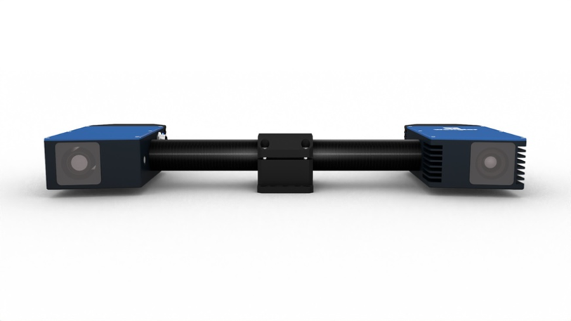
Shape Drive G4 (3D Sensors)
The device consists of a camera and a Projector which works on the triangulation principle used for creating an angle between the sensor and the object to measure distance between them and produce the 3D point cloud.
It mainly has a microcontroller unit and an FPGA unit which interact together to achieve the functionalities.
High point cloud quality with up to four 3D point clouds per second.
Integrated 3D point cloud calculation.

Slide 5
Acknowledgment
In Today’s world of industrial automation, every application is largely dependent on the precision and reliability of the data.
The reliability of the data is ensured by making the communication between the sensors and user/control system robust and giving some feedback to ensure the correctness and reliability of the real time data produced.
To facilitate this efficient interaction and to ensure that the sensor works efficiently, an ASCII acknowledgment response system is to be implemented as part of the G4 sensor’s firmware.
This system provides a reliable method for verifying the successful execution of commands, thus improving the user-friendliness and reliability of the sensors.

Slide 6
Motivation and Objectives
Section II

Slide 7
Motivation – Ensuring Reliability
communication and performance of the devices.
Ensuring the ASCII commands are reliably sent, received, and validated.
“The lack of active acknowledgment responses in the current G4 product platform prevents users from knowing the real-time status of ASCII command execution, reducing the sensor’s user-friendliness and reliability. This project aims to develop an acknowledgment response system to address this issue.”

Slide 8
Research Objectives
The Main Objective of this master thesis is to create an Acknowledgment response handler for the ASCII Command Functions of Shape Drive G4 3D Sensors for making it more user-friendly.
To implement acknowledgment response for all existing ASCII Commands.
To make the acknowledgment response feature configurable according to the wish of the user.
To create a modular command handler that handles all the ASCII commands and their acknowledgment.
To set a standard format for the generated acknowledgment responses.
Implementing a limit check functionality for all ASCII Commands inorder to prevent the sensor from applying garbage values incase of outbound input values.
Testing and verifying the responses to ensure reliability and performance of the implemented system.

Slide 9
Methodology
Section III

Slide 10
Methodology
Phase I
Phase II
Phase III
Concept development
Modification of Firmware Architecture and Implementation
Hardware Setup
1.ShapeDrive G4 3D Sensor
Methodology
Existing Firmware Architecture
Software Setup
1.Linux Environment
2. Toolchain
Design Decisions
Testing and Verification

Slide 11
Concept Development
start
Send ASCII Command
Command Parsing
Invalid ASCII command
False
True
Command Execution
ACK I
Success
Acknowledgment Generation
Failure
Send Success to PC Console
ACK II ( Command Execution)
Send Failed to PC Console
End Communication

Slide 12
Existing Firmware Architecture

Slide 13
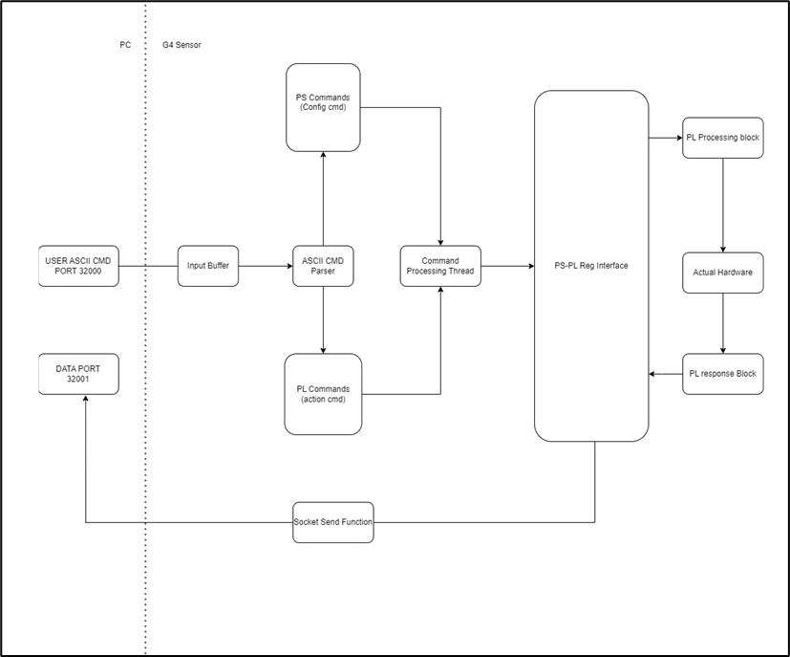

Slide 14
Design Decisions
Acknowledgment Format Definition.
XML Container Format.
Container ID
Container Size
Command Acknowledgment
Sub-container ID
Sub-container size
Command Acknowledgment Data
CRC PS ID
CRC Size
CRC Data value

Slide 15
XML Container with CRC check
An XML container refers to a structured data format using Extensible Markup Language (XML) to encapsulate and represent information. XML is a widely used markup language that organizes data in a hierarchical and human-readable format with clear tags and attributes. Each "container" typically includes elements (tags) that hold data and metadata, making it easy to parse, interpret, and share information across systems.
Cyclic Redundancy Check (CRC) is a widely used error-detection mechanism to ensure the integrity of data during transmission or storage.
The acknowledgment response system implemented as a part of this thesis is using XML language and it is in form of a container and along with it CRC check is also attached to act as an error detection mechanism.

Slide 16
Design Decisions
2. Command Acknowledgement Data
current
user_value
min
max
execution_time
command
3. Command Classification
COMMAND_TYPE_ACTION
COMMAND_TYPE_ENUM_PARAM
COMMAND_TYPE_RANGE_PARAM
COMMAND_TYPE_NO_ACK
COMMAND_TYPE_ACK_CHECK

Slide 17
Design Decisions
4. Command structure for command handler.
The command name.
Command type (COMMAND_TYPE_ACTION, etc.).
FPGA parameters (fpgapara) that control the hardware behaviour.
The current value variable to hold the current set value of the functions.
Limit values (min/max).
The initial value function pointer for storing default value.
The handler function pointer to hold the command implementation functions.
5. Parsing Function Modification.
6. Limit check Function for error handling

Slide 18
Implementation Workflow diagram

Slide 19
Modified firmware architecture with Acknowledgment Handler

Slide 20
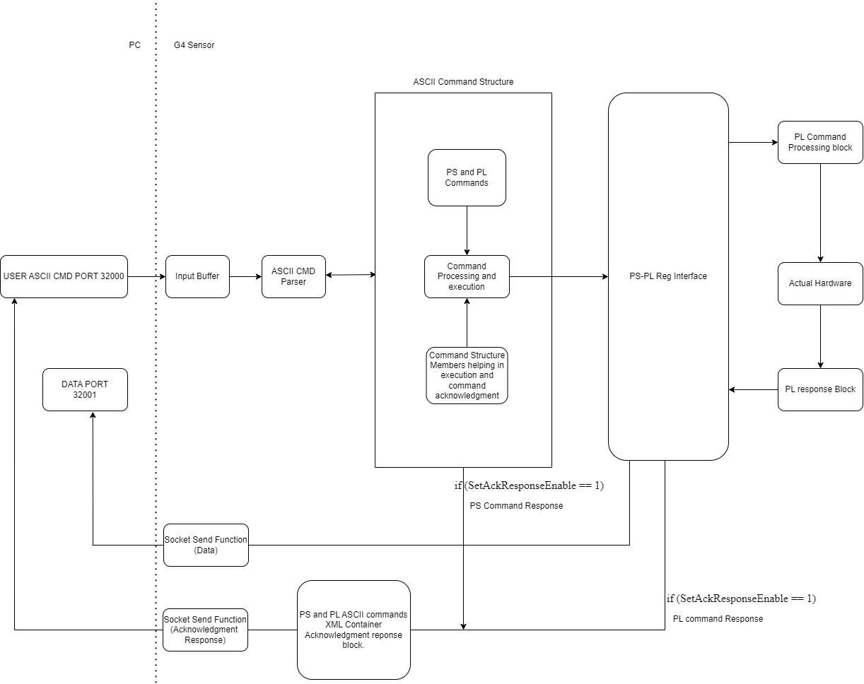

Slide 21
Testing and verification
The acknowledgment response system was tested and validated throughout the development process.
The testing were done using NetCat and WeDEV Tool.
The testing were done in both normal mode (Normal test) and at high speed (Stress test).

Slide 22
RESULTS
Section IV

Slide 23
Results: Using NetCat
SetAckResponseEnable=1
Valid Value Test
SetTriggerSource=2
Valid Value Test. (enum Type ASCII Command)

Slide 24
SetTriggerSource=-4
Invalid Value Test (enum Type ASCII Command)
SetTriggerSource=7
Invalid Value Test (enum Type ASCII Command)

Slide 25
SetExposureTimeLimit=50000
Valid Value Test (Range Type ASCII Command)
SetExposureTimeLimit=93000
Invalid Value Test (Range Type ASCII Command)
SetExposureTimeLimit=-34
Invalid Value Test (Range Type ASCII Command)

Slide 26
SetAcquisitionStart
Valid Value Test(Action Type ASCII Command)
SetAcquisitionStart=4
Invalid Value Test(Action Type ASCII Command)

Slide 27
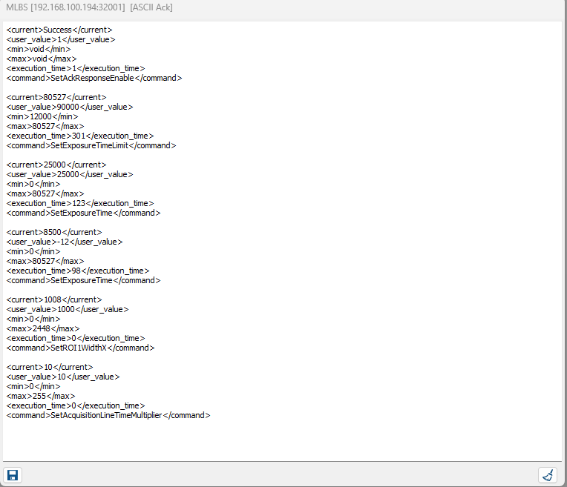
Results: using WeDEV Tool

Slide 28
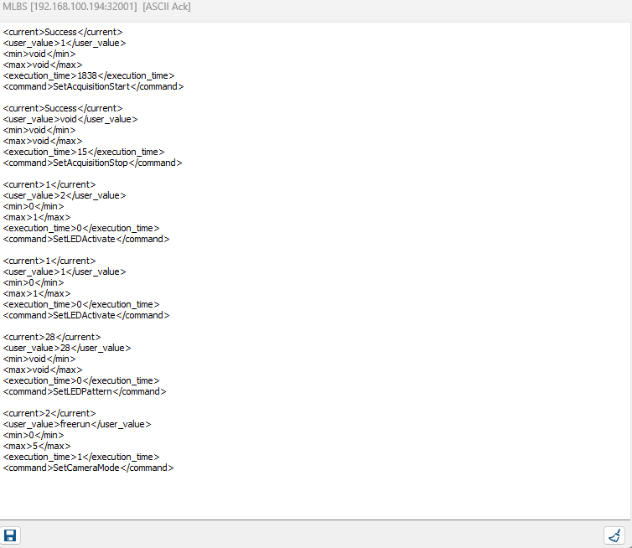

Slide 29
Conclusion and Future Scope
Section V

Slide 30
Conclusion
Implemented a Modular Acknowledgment response system for all existing ASCII Commands.
Created an ASCII Command SetAckResponseEnable for configuration purpose. This enables the user to enable or disable the acknowledgment response feature.
The Acknowledgment Format in which the responses are generated is XML. The XML based acknowledgment response is handled and sent using a container in order to ensure the data integrity .
Implemented a command handler, which act as a central registry for all ASCII commands and is seamlessly integrated to the firmware. Along with this the command parsing functionality is also modified which is now working in hand in hand with the command handler.
Added a limit check functionality for all ASCII Commands inorder to ensure safety of the device .
Tested and verified the acknowledgment response feature using NetCat and WeDEVTool (developer application) and ensured the reliability and responsiveness of the implemented acknowledgment response system.
Stress testing
Normal testing

Slide 31
Future Scope
Adding GET Commands and their acknowledgment responses.
Adding new attributes to the command acknowledgment data like error codes for each type of error.
Creating a python test for automation of the Acknowledgment response feature.

Slide 32
Thankyou

